Slide 1




The Atlantic x Product Space
Final Presentation
April 2026

Slide 2







Meet the Team
(image)
(image)
Janice Ku
Project Manager
Olivia Zhao
Senior Product Analyst
(image)
(image)
(image)
(image)
Quisha Lee
Product Analyst
Ashrit Manduva
Product Analyst
Aayan Ali
Product Analyst
Luke Keller
Product Analyst
David Xie
Product Analyst
Product Space @ Georgetown | 2

Slide 3
01
02
03
04
05
Overview
Project Research, Work, and Sections
Survey
Methodology & Analysis
PRD 1
Split-Screen Comments With Article Quoting
PRD 2
Algorithm and Comment Incentive
Project Overview
Final Recommendations
Product Space @ Georgetown | 3

Slide 4
Overview
01
Product Space @ Georgetown | 4

Slide 5
Project Outline
01
02
03
04
05
Competitor Audits
21 platforms audited along 8 categories
Feature Identification
7 features identified, 4 selected
Data Collection & Analysis
86 survey responses collected
Product Requirement Docs
Two PRDs written for 4 features
Figma
Mock Ups
Three Figma mockups created for 5 features
Product Space @ Georgetown | 5

Slide 6
Primary Research
Initial Results & Analysis
02
Product Space @ Georgetown | 6

Slide 7
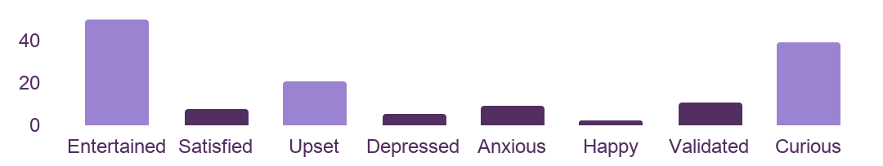
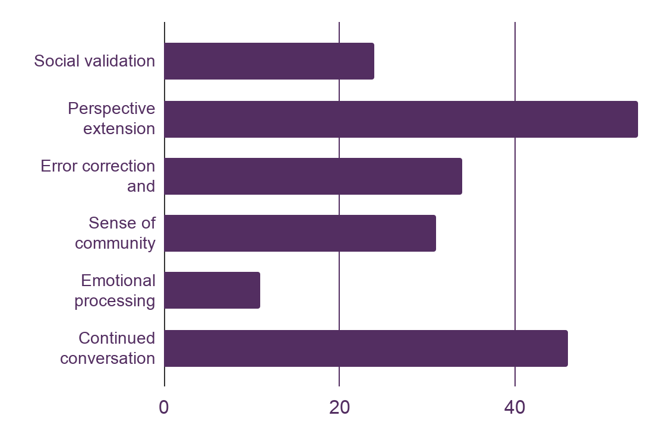
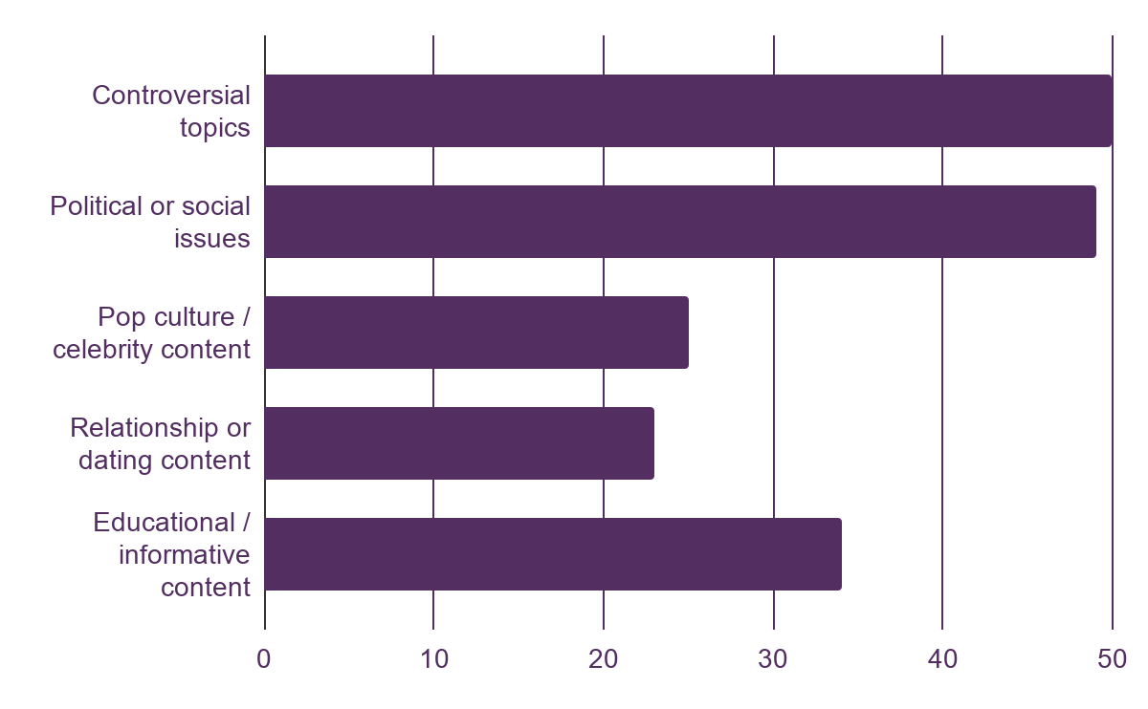
Midterm Findings Recap
The more active the discussion and the more diverse the perspectives, the better
Q: How do disagreements in comment sections make you feel?
Q: What do you get from comments that you do not get from the work itself?
Q: What type of content most often leads you to the comments?
Product Space @ Georgetown | 7
Notes:
Since the midterm presentation, we were able to double our survey collection count, reaching a total of 86 survey responses
All respondents were between the ages of 18 and 24
What has not changed since then, however, has been our findings
The general idea that people want to expand their perspectives, hear from diverse opinions, and engage in direct conversation with each other still holds
See: Peaks for “perspective extension” and “continued conversation”
See: Attraction to “controversial topics” or “political or social issues”—conversation starters
See: Positive responses to seeing disagreements in comment sections

Slide 8
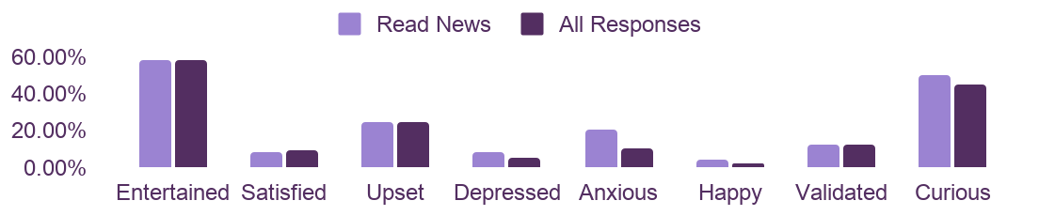
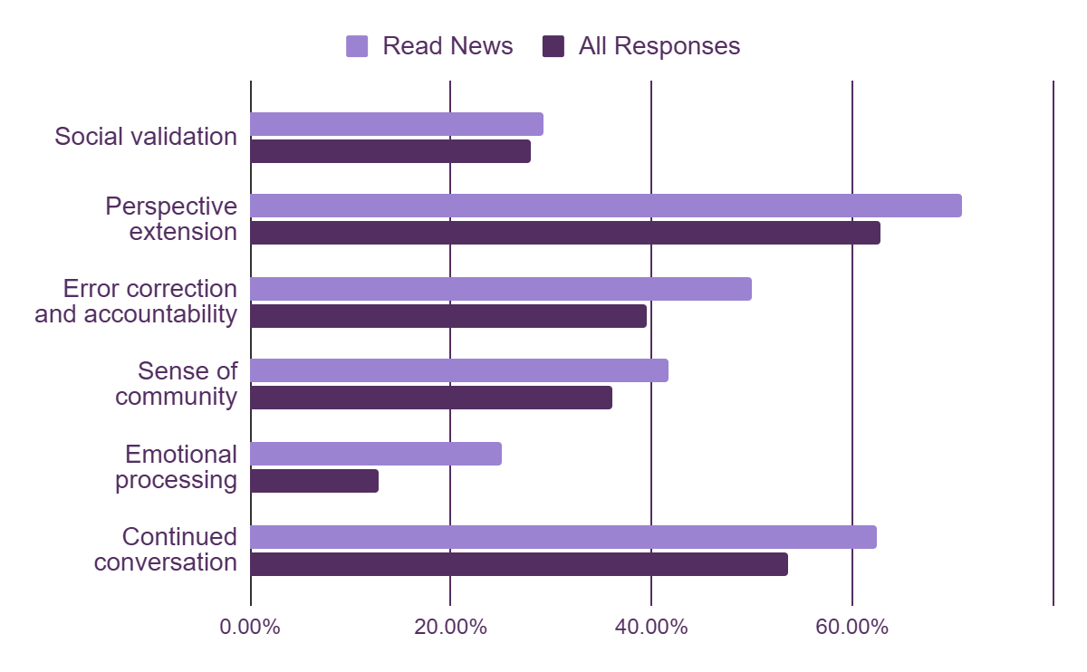
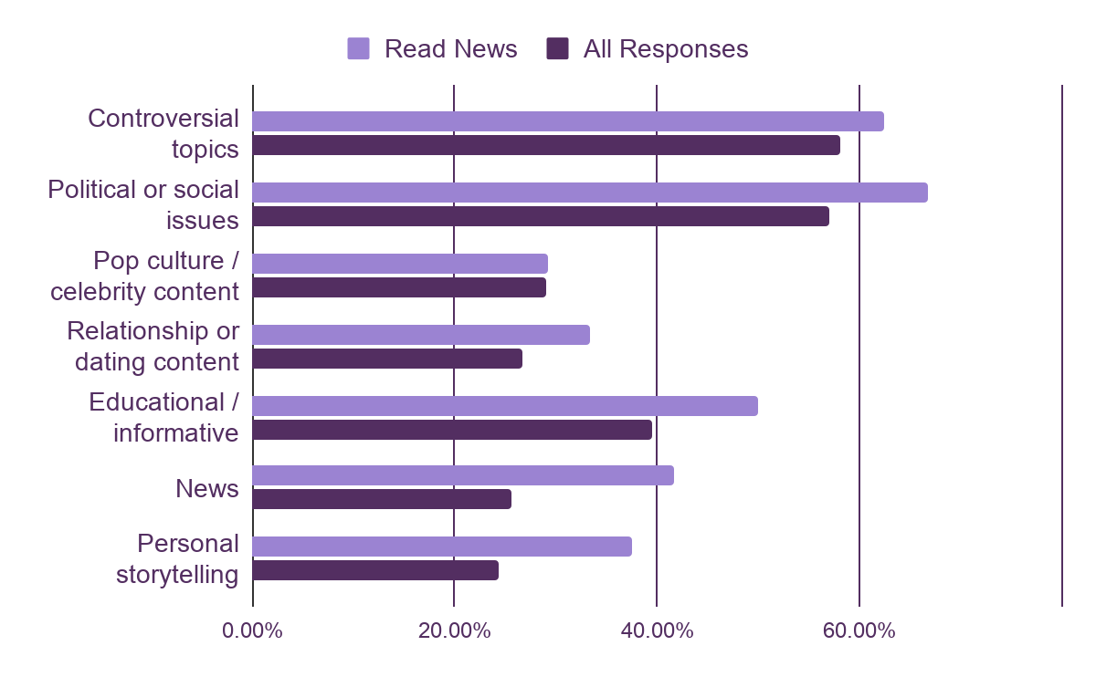
Results by Segmentation
Greater attention paid to hearing perspectives and accountability, importance of personal elements, danger of anxiety
Q: How do disagreements in comment sections make you feel?
Q: What do you get from comments that you do not get from the work itself?
Q: What type of content most often leads you to the comments?
Product Space @ Georgetown | 8
Notes:
With the additional responses, we can now segment out results for respondents who stated they read comment sections for news sites in particular
In general, the most prominent differences are that news readers find greater value from feeling more connected to the original author through comment sections, whether in the form of error correction and accountability or personal storytelling, and a slightly higher risk of finding comment section disagreements to be anxiety-inducing
So, while news readers largely want the same things as comment browsers overall, these findings suggest that in the news space, there is a premium on author engagement and that a social media-esque approach of maximizing attention by promoting controversial comments would be quite unfavorable

Slide 9
PRD 1
UI/UX Barriers to Commentary
03
Product Space @ Georgetown | 9

Slide 10
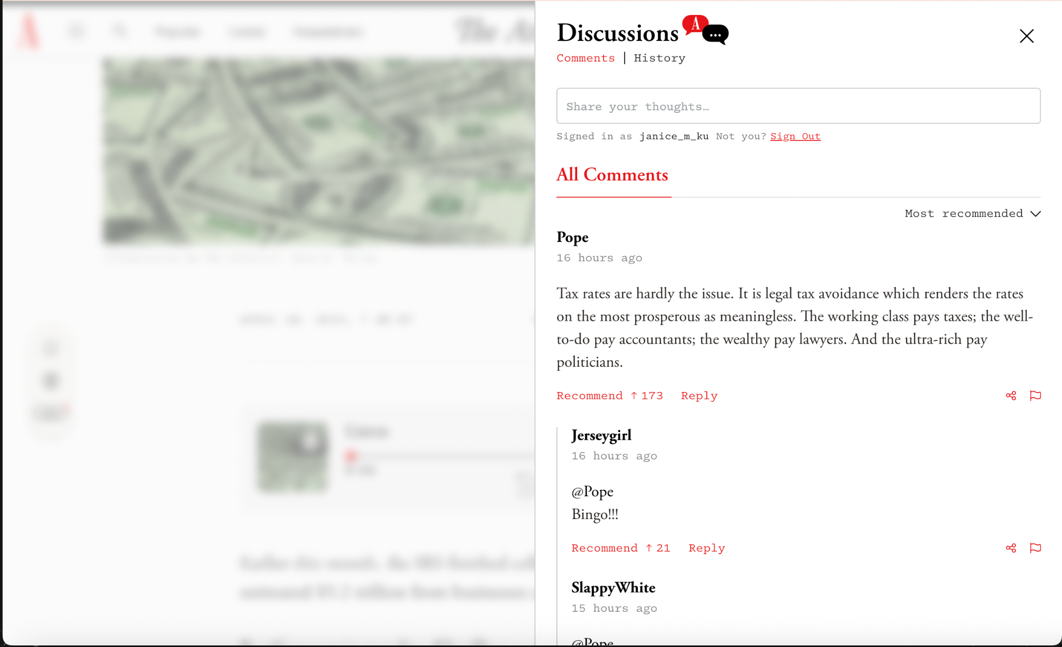
PRD 1: Split Screen & Article Quoting
Improving Comment Engagement Through Contextual Reading
Readers struggle to have meaningful article discussion in comments; referencing the article creates friction.
Obstacle: The article text is blurred and covered by the comments pane, forcing context-switching and taxing working memory.
Solution: A split-screen view with a highlight-to-quote feature that keeps the article visible alongside comments.
Survey insight: Readers come to comments to hear new perspectives and engage with others — split-screen removes the barrier to doing both at once.
Current comments view: Article is blurred and partially covered
Product Space @ Georgetown | 10

Slide 11
Feature Proposal
Split Screen & Article Quoting
Two linked features reducing friction in article-to-comment flow. Article quoting lowers cognitive load and mimics how Gen Z engages with shorter-form content.
User story
Definition
KPIs
As a reader, I want to see the full article while reading comments so I can reference specific passages
As a potential commenter, I want to highlight and quote article text directly into my comment
As a commenter, I want others to see which passage I’m responding to
Split-screen view: article on left ⅔ stays fully unblurred and scrollable, with comment pane separately scrollable on right ⅓
Highlight-to-quote: select any article passage and insert as a block quote in one click
Precedent: Medium highlights, Substack quote restacks, TikTok dual-view
Comment submission rate: rate of comments in split-screen vs. baseline articles
Article quoting adoption: share of comments containing at least one quoted passage
Avg. comment length & return-visit rate: change in average length of comments & the percentage of readers who open the comments 2+ times
Product Space @ Georgetown | 11

Slide 12
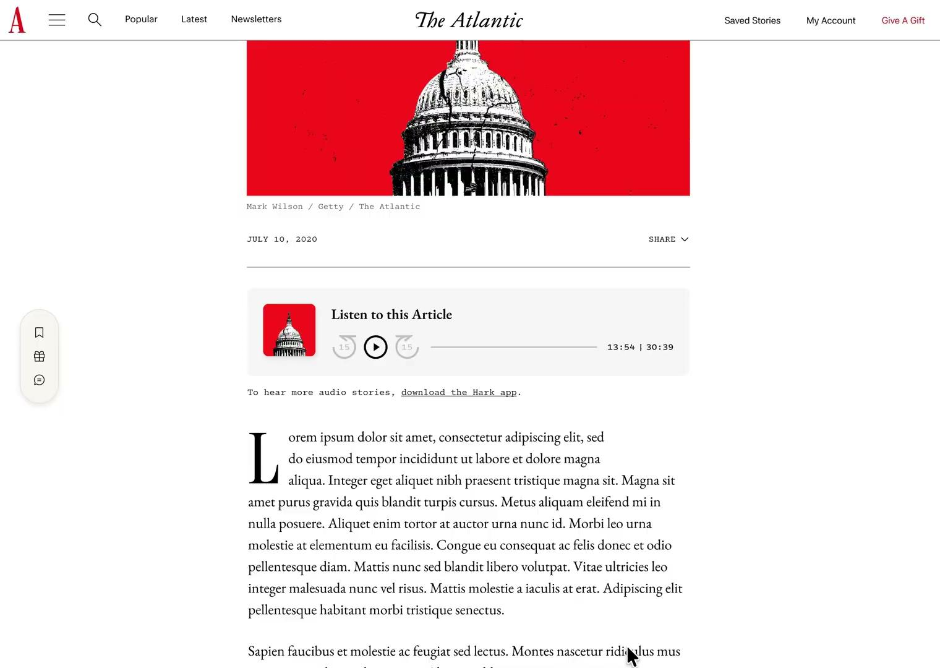
UI/UX Choices & Figma Demonstration
Seamless Reading-to-Commenting User Journey
Highlight article text to quote
Clicking on in-article “quote” option
brings user straight to comment section
Split screen dual view
View comments simultaneously besides
the article
Condensed & toggleable
view of quotation
Quotes minimized by default to maximize
screen real estate
Product Space @ Georgetown | 12

Slide 13
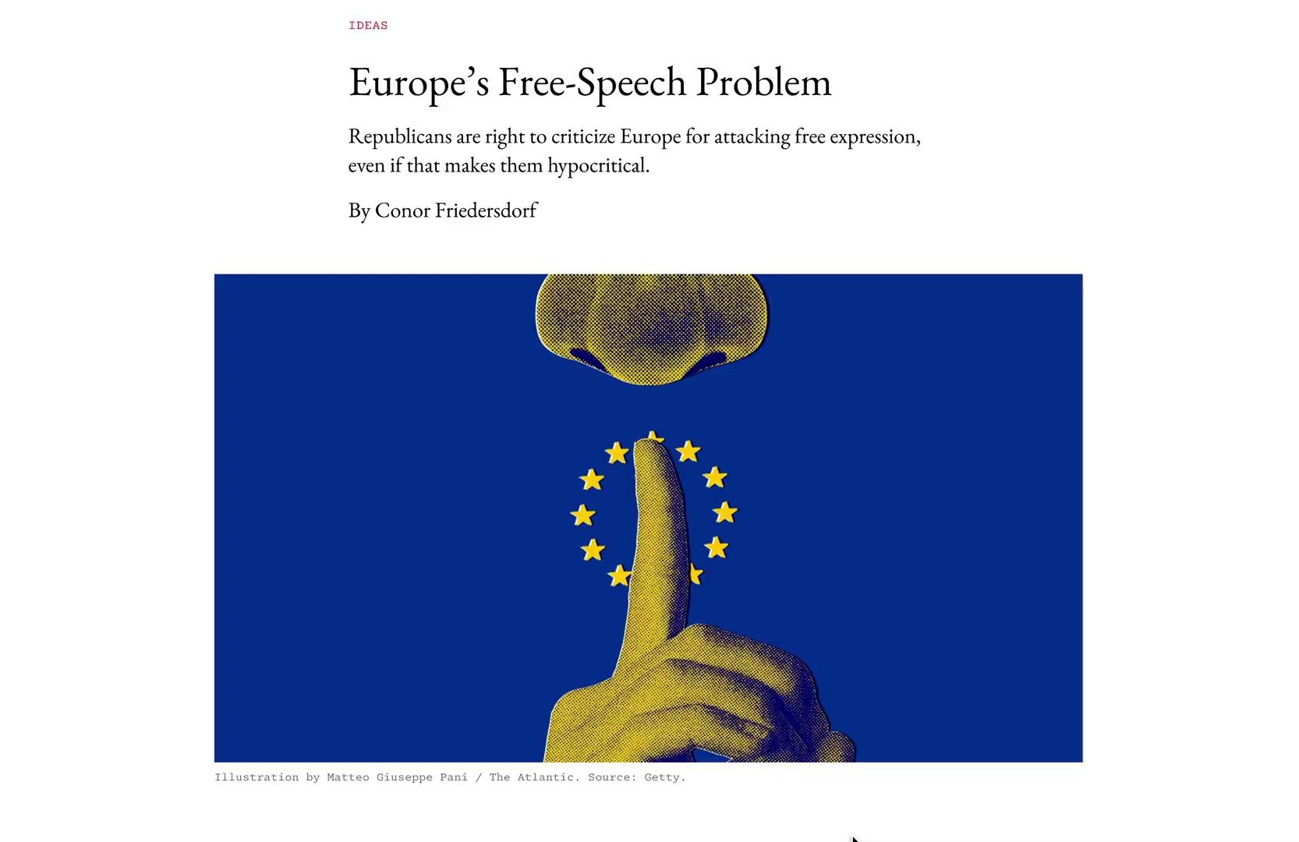
UI/UX Choices & Figma Demonstration
Bridge from Article Reading to Quote-Driven Discussion
End article with “Most Quoted”
Readers flow through article linearly into
an incentive to engage further
Pulls user into comment section
Encourage substantive engagement
with article through discussing quotes
Dual-pane viewing & scrolling
Allows for independent scrolling on each
side of the screen without disrupting
user’s current position
Product Space @ Georgetown | 13

Slide 14
PRD 2
Incentives to Comment
04
Product Space @ Georgetown | 14

Slide 15
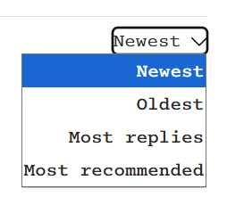
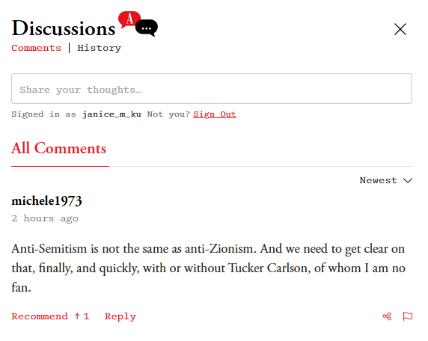
PRD 2: Algorithm & Author Indicator Feature
Boosting Incentives to Comment via Engaging Perspectives
Users must overcome frictions when searching for valuable or provocative insights in comment sections.
Obstacle: The user has difficulty finding interesting or highly engaging opinions, reducing urge to read or comment.
Solution: Distinct authorship indicators; a
comment sorting algorithm that prioritizes trustworthy, eye-catching contributions
Survey insight: Maximizing direct conversation and engagement + conduit for accountability
Current default to “Newest” or most recent sort setting
Product Space @ Georgetown | 15

Slide 16
Feature Proposal
Author Badges & Comment Sorting Algorithm
Author indicators give Gen Z the access to creators they expect, and the sorting algorithm pushes forth the most engaging opinions.
User story
Definition
KPIs
As a reader, I want to verify what others think is worth discussing so I can see the best conversations
As a reader, I want to see how the author responds to readers’ opinions to expand my understanding
As a commenter, I want to be rewarded for an intellectual contribution
Algorithmic Sorting: Three-layer comment ranking system using a Wilson Score with Bayesian smoothing
Author Badges: Atlantic A symbols to mark Atlantic staff contributions
Precedent: “From NYT,” Substack, all social media comments
Comment-to-View Ratio: the proportion of Comments/Viewers
Conversation Depth: Average # of Comments in a Thread
Average Recommend Count: The average number of recommends comments receive in an article’s comment section
Product Space @ Georgetown | 16

Slide 17
3-Layer Algorithm
Wilson Score, Bayesian Smoothing, Commenter Trust Score, and Implementation
Maximizing engagement without compromising quality
Wilson Score +
Bayesian Smoothing
Commenter Trust Score
Implementation
Prioritization: Ranks comments by upvote confidence, not raw count
Volume-agnostic: Corrects for low vote volumes at The Atlantic's scale
Including all readers: Mild time-decay keeps newer comments competitive
Backend only: Never surfaced to users
Rewarding reliability: Modest 20% boost for consistently high-quality contributors
Including new readers: New users remain competitive from their first comment
Default setting: Replace chronological default with quality-first ranking
Maintain options: Keep "Latest" as sort feature for users who want it
Feasibility: Implementable on existing tech stack (no ML required)
Product Space @ Georgetown | 17
Notes:
Atlantic picks should be removed, commenter trust score stays - and condense this part and wilson score and bayesian smoothing to be on one slide. But mention atlantic picks - so that it can be covered by me explaining it. This slide should be condensed with the previous slide too to become one slide. Think about the flow of the presentation again.

Slide 18
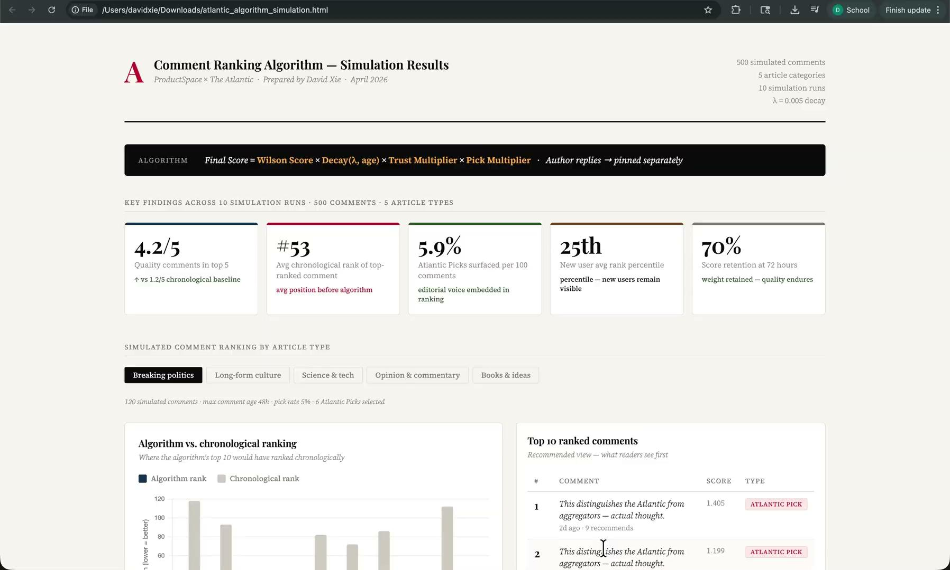
Algorithm Backtest
Key Findings
Quality comments in top 5: 3.8/5 vs. 1.2/5 chronological baseline
Algorithm surfaces comments ranked as low as #47 chronologically
Atlantic Picks visible in top results without crowding organic ranking
New users remain competitive with trust boost capped at 20%
Product Space @ Georgetown | 18

Slide 19
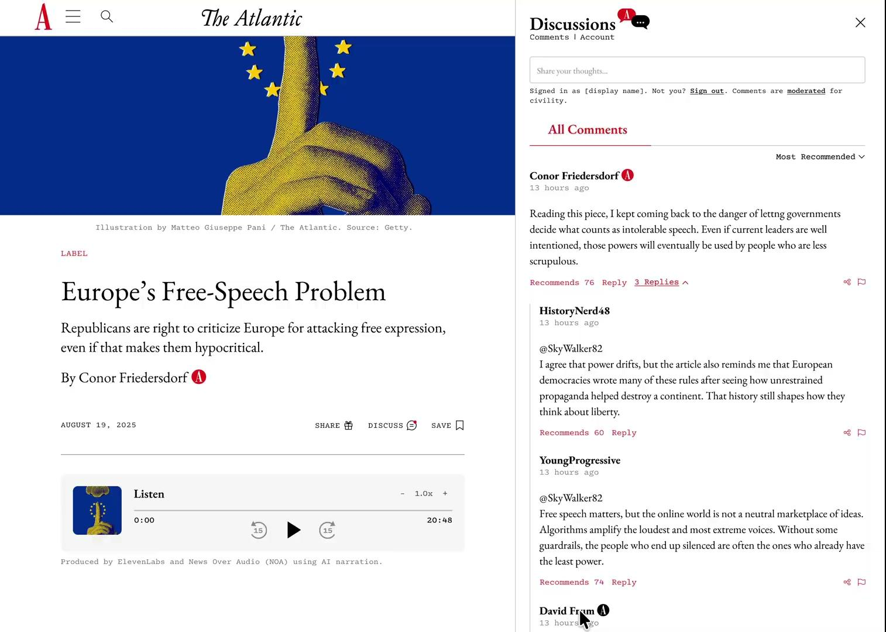
UI/UX Choices & Figma Demonstration
Authorship Visibility and Algorithm Menu Clarity
Author vs. Other Journalists
Red “A” identifies article author
Black “A” identifies newsroom staff
Standardized Default
Recommended Comments
Most recommended comments shown
first for all users across the platform
Rounded Algorithm Menu
Softer menu shape and whitespace
to improve readability
Product Space @ Georgetown | 19

Slide 20
Project Overview
Summary
05
Product Space @ Georgetown | 20

Slide 21
Recommendations
Allow readers to view comments and article simultaneously
Reducing friction in moving between article content and comments section will remove a barrier to commenting.
Create an article quoting feature to tie comments to article content
Allowing users to directly tie in the article to comments will bring conversations closer to content.
Distinguish article authors/Atlantic staff in comments section to elevate conversation
Visually indicating author interactions with commentators will incentivize readers to leave higher quality comments.
Rewrite the comment sorting algorithm to better meet reader needs
Sorting the comments section by a three-layer comment ranking algorithm will bring readers to conversations they will want to see.
Product Space @ Georgetown | 21

Slide 22
Deliverables
Competitor Matrix
Features Matrix
PRD 1
PRD 2
Figma Mockup 1: Split Screen + Article Quoting; Most Quoted
Figma Mockup 2: Author Interactions + Algorithm
Survey Data
Product Space @ Georgetown | 22

Slide 23
Thank you!
Contact jk2385@georgetown.edu with questions or inquiries
Product Space @ Georgetown | 23

